Slide 1
Data Argumentation: Mixup training (learning principle )
Mengdie Huang
Group AI Security, Lab Ruiyun
School of Cyber Engineering, Xidian University, Xi’an
Idea
2020-10-12

Slide 2
1
Overview
Contents
Issues
Causes Analysis
Inspiration
Related Work
Flaws
Solution
Manifold Mixup
Input Mixup
Mixup inference
Adaptive Mixup
Puzzle Mixup
Adversarial Mixup
Keywords
Research methods
Prior Works
Cut Mixup

Slide 3
2
Issues
Mixup (namend Input Mixup)
Contradiction between Neural networks and ERM [V. N. Vapnik. Statistical learning theory. J. Wiley, 1998.]
The convergence of ERM is guaranteed as long as the size of the neural network does not increase with the number of training data. [V. Vapnik and A. Y. Chervonenkis. On the uniform convergence of relative frequencies of events to their probabilities. Theory of Probability and its Applications, 1971.]
The size of state-of-the art neural networks scales linearly with the number of training examples.
Flaws:
ERM allows large neural networks to memorize (instead of generalize from) the training data even in the presence of strong regularization, or in classification problems where the labels are assigned at random. [C. Zhang, S. Bengio, M. Hardt, B. Recht, and O. Vinyals. Understanding deep learning requires rethinking generalization. ICLR, 2017.]
Neural networks trained with ERM change predictions drastically when evaluated on examples outside the training distribution, also known as adversarial examples. [C. Szegedy, W. Zaremba, I. Sutskever, J. Bruna, D. Erhan, I. J. Goodfellow, and R. Fergus. Intriguing properties of neural networks. ICLR, 2014.]
Data augmentation [P. Simard, Y. LeCun, J. Denker, and B. Victorri. Transformation invariance in pattern recognition tangent distance and tangent propagation. Neural networks: tricks of the trade, 1998.]
VRM [O. Chapelle, J. Weston, L. Bottou, and V. Vapnik. Vicinal risk minimization. NIPS, 2000.]
In VRM, Human knowledge is required to describe a vicinity around each example in the training data.
Additional virtual examples can be drawn from the vicinity distribution of the training examples to enlarge the support of the training distribution.
Flaws:
Procedure is dataset-dependent, and thus requires the use of expert knowledge.
Data augmentation assumes that the examples in the vicinity share the same class, and does not model the vicinity relation across examples of different classes.
Research Target:
Use data argumentation method to forget training data and guarantee robust prediction performance on examples outside the training distribution.
Improve VRM without requirement of expert knowledge and model the vicinity relation across examples of different classes.

Slide 4
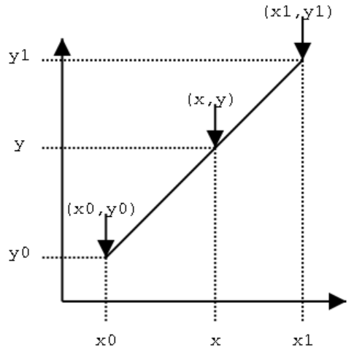




2
Issues
Manifold Mixup
DNN
Flaws:
deep learning systems quickly degrade in performance as the distributions of training and testing data differ slightly from each other. provide incorrect and confident predictions when evaluated on slightly different test examples, including distribution shifts, outliers, and adversarial examples.
Deep learning systems are being deployed in settings where data may be subject to distributional shifts.
decision boundary
Flaws: decision boundary is sharp and close to the data.
hidden representations and
Flaws: majority of the hidden representation space corresponds to high confidence predictions, both on and off of the data manifold.
Word Embedding study
king − man + woman ≈ queen
interpolations are an effective way of combining factors [Mikolov, T., Chen, K., Corrado, G., and Dean, J. Efficient estimation of word representations in vector space. In International Conference on Learning Representations, 2013.]
high-level representations are often low-dimensional and useful to linear classifiers, linear interpolations of hidden representations should explore meaningful regions of the feature space effectively.
Research Target:
Smooth decision
Reduce the prediction confidence of hidden representation of Out-of-Manifold data
Solution:
This is a regularizer / learning principle.
use linear combinations of hidden representations of data
perform the same linear interpolation in the associated pair of one-hot labels, leading to mixed examples with soft targets.
What is linear interpolations ?
$$\frac{y−y_{0}}{x−x_{0}}=\frac{y_{1}−y_{0}}{x_{1}−x_{0}}$$
$$\frac{y−y_{0}}{y_{1}−y_{0}}=\frac{x−x_{0}}{x_{1}−x_{0}}=k$$
$$y−y_{0}=k\left(y_{1}−y_{0}\right)$$
$$y=k\left(y_{1}−y_{0}\right)+y_{0}=\left(1−k\right)y_{0}+ky_{1}$$
Notes:
插值: 根据已知的数据序列（可以理解为你坐标中一系列离散的点），找到其中的规律，然后根据找到的这个规律，来对其中尚未有数据记录的点进行数值估计.
线性插值: 针对一维数据的插值方法。它根据一维数据序列中需要插值的点的左右临近两个数据来进行数值估计。

Slide 5
2
Issues
Adaptive Mixup (adaptive version of MixUp)
Lack explanation of Mixup
Mixup is primarily established empirically. its working and effectiveness have not been explained in any depth.
limitation of MixUp
manifold intrusion：under-fitting resulting from conflicts between the synthetic labels of the mixed-up examples and the labels of original training data.
parameters controlling the generation of mixing policies are not sufficiently fine-tuned on the training data. The mixing (i.e., interpolation) policies in MixUp are controlled by a global hyper-parameter α, which needs to be tuned by trial and error on the data set.
makes MixUp inconvenient to use. It’s not clear that what role such a parameter controls and how to tune it properly.
Regularization schemes
data-independent regularization: imposes constraints on the model by penalizing various forms of the norm of the network parameters, without exploiting the distribution of data.
weight decay [Hanson, S. J., and Pratt, L. Y. 1988. Comparing biases for minimal network construction with back-propagation. In NIPS1988, 177–185.]
dropout [Srivastava, N.; Hinton, G.; Krizhevsky, A.; Sutskever, I.; and Salakhutdinov, R. 2014. Dropout: A simple way to prevent neural networks from overfitting. J. Mach. Learn. Res. 15(1):1929–1958]
data-dependent regularization: constrains the parameter space of the model in a way that depends on the distribution of the data.
data augmentation [Simard, P.; LeCun, Y.; Denker, J. S.; and Victorri, B. 1998. Transformation invariance in pattern recognition-tangent distance and tangent propagation. In Neural Networks: Tricks of the Trade, This Book is an Outgrowth of a 1996 NIPS Workshop, 239–27.]
adversarial training [Goodfellow, I. J.; Shlens, J.; and Szegedy, C. 2014. Explaining and harnessing adversarial examples. CoRR abs/1412.6572.]
information bottleneck based regularization [Alemi, A. A.; Fischer, I.; Dillon, J. V.; and Murphy, K. 2016. Deep variational information bottleneck. CoRR abs/1612.00410]
Research Target:
Explain Mixup
Avoid Manifold intrusion.
Fine tune parameters sufficiently that control the generation of mixing policies.
Notes:
Mixup：实质上是一种流形外的正则化，通过在训练数据附近进行线性插值，从而对数据流形外的输入空间施加局部线性约束。
流形入侵：混合样本点的虚拟语义标签与原始训练样本点的标签之间存在冲突（不一定肯定是同样的标签，VRM就假设了是同样的标签）因而mixup线性插值会导致混合样本点与原始训练样本点拟合不足。

Slide 6
2
Issues
Cut Mixup
Random feature removal regularizations
Dropout : randomly drop hidden activations [Nitish Srivastava, Geoffrey Hinton, Alex Krizhevsky, Ilya Sutskever, and Ruslan Salakhutdinov. Dropout: A simple way to prevent neural networks from overfitting. Journal of Machine Learning Research, 15:1929–1958, 2014]
Regional dropout : erasing random regions on the input [Terrance DeVries and Graham W Taylor. Improved regularization of convolutional neural networks with cutout. arXiv preprint arXiv:1708.04552, 2017]
Regional dropout
remove informative pixels on training images by overlaying a patch of either black pixels or random noise, leading to information loss and inefficiency training.
Deleted regions are usually zeroed-out or filled with random noise, greatly reducing the proportion of informative pixels on training images. [We recognize this as a severe conceptual limitation as CNNs are generally data hungry [26]]
How can we maximally utilize the deleted regions, while taking advantage of better generalization and localization using regional dropout? (letting a model attend not only to the most discriminative parts of objects, but rather to the non-discriminative parts of objects)
Mixup
samples tend to be unnatural
Solution：
replace the removed regions with a patch from another image
Research Target:
Release the information loss in the deleted regions on training images
Increase the proportion of informative pixels in deleted regions on training images
overcomes the problem of unnatural
Notes:
当前的区域缺失通过覆盖黑色像素或随机噪声的补丁来去除训练图像上的信息像素。 这样的删除会导致信息丢失以及培训期间的效率低下。
在传统regional dropout中，删掉像素的块区内都是o或者是随机噪声。
CutMix现在享有的特性是，在训练过程中不会出现非信息像素，从而提高了训练效率，同时保留了区域掉落以处理对象的非歧视性部分的优势。 通过要求模型从局部视图识别对象，添加的补丁进一步增强了定位能力。 训练和推理成本保持不变

Slide 7
2
Issues
Adversarial Vertex Mixup
Adversarial training
Adversarial empirical risk minimization (AERM) [Aleksander Madry, Aleksandar Makelov, Ludwig Schmidt, Dimitris Tsipras, and Adrian Vladu. Towards deep learning models resistant to adversarial attacks.]
Adversarial Feature Overfitting (AFO): the model overfitting to the adversarial features during adversarial training leading to poor robust generalization.
adversarial training can overshoot the optimal point in terms of robust generalization, leading to AFO in our simple Gaussian model.
Larger sample complexity
Robust training requires larger sample complexity than that of standard training [Ludwig Schmidt, Shibani Santurkar, Dimitris Tsipras, Kunal Talwar, and Aleksander Madry. Adversarially robust generalization requires more data. In Advances in Neural Information Processing Systems, pages 5014–5026, 2018.]
How to find a trade-off may exist between adversarial robustness and standard accuracy [Dimitris Tsipras, Shibani Santurkar, Logan Engstrom, Alexander Turner, and Aleksander Madry. Robustness may be at odds with accuracy. arXiv preprint arXiv:1805.12152, 2018.]
Rely on obfuscated gradients
Solution
a soft-labeled data augmentation
Research Target:
Analysis how much the change in the variance of the feature representations affects the robust generalization
Reduce the fitting to the adversarial features
Don’t overshoot the optimal point
Enlarge sample complexity
Notes:
对抗训练时过拟合到对抗特征：说明输入特征的representation协方差过大，对抗特征和标准特征分的特别散，导致在某个对抗特征上超过最佳点的过度学习很难泛化到其他标准特征上。
Overfitting: If you can fit the training data, but large error on testing data, then you probably have large variance

Slide 8
2
Issues
Puzzle Mixup
Mixup based augmentation
Memorize the training data
Make overconfident predictions
the underlying data domains contain rich regional saliency information, and exhibit local regularity structure far from random matrices of numbers. completely disregarding these aspects of data could lead to creating mixup examples which could misguide the training model and undermine the generalization performance.
Research Target:
Utilize rich regional saliency information and local regularity structure to create mixup examples
multi-label objective for optimal mixing mask
saliency discounted optimal transport objective

Slide 9
3
Related Work
Adaptive Mixup Contribution:
develop an understanding for MixUp as a form of “out-of-manifold regularization”, which imposes certain “local linearity” constraints on the model’s input space beyond the data manifold.
Explanation: different from all previous data dependent regularization, Mixup imposes constraints by making use of the regions in the input space of the model that are outside of the data manifold.
mixing policies are automatically learned from the data using an additional network and objective function designed to avoid manifold intrusion.

Slide 10
4
Flaws

Slide 11
5
Causes Analysis

Slide 12
6
Inspiration

Slide 13
7
Solution

Slide 14
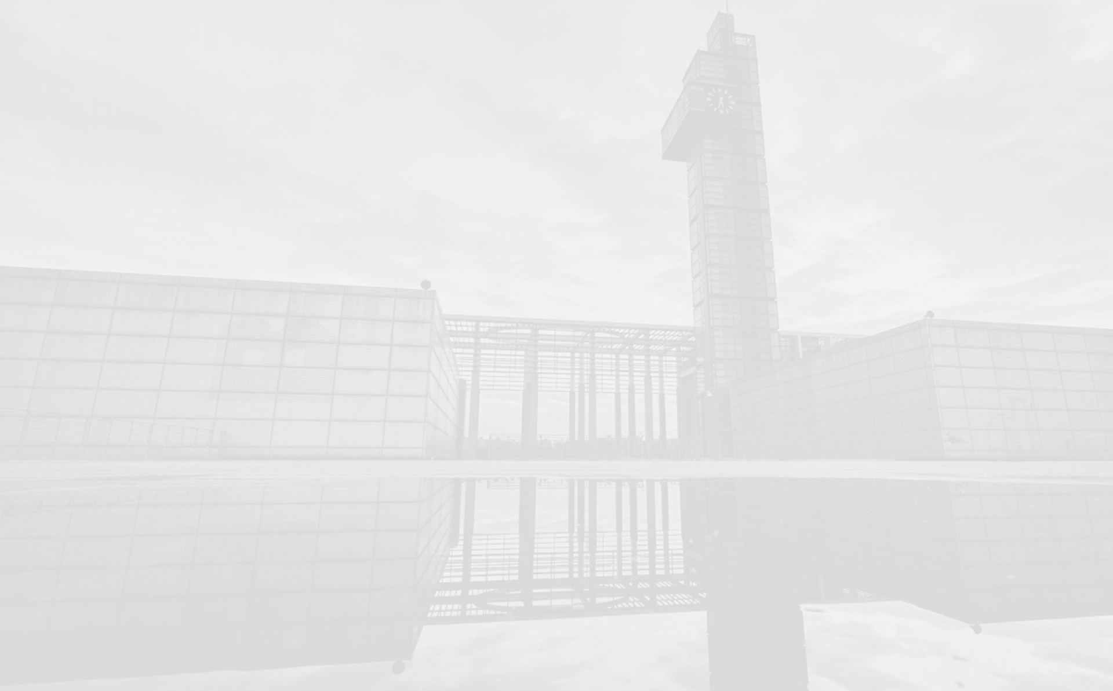


Thank you !
Mengdie Huang
Group AI Security
Lab Ruiyun
2020-10-12

